Slide 1

Indian Institute of Carpet Technology, Bhadohi
FOREST RESOURCES: AVAILABILITY
Presented by:
Dharmendra

Slide 2

Forest Resources: Availability and Sustainability
This presentation explores forest resources, their global distribution, and sustainable management.
We'll cover ecological, economic, and social benefits. Also, we'll explain present threats and future conservation.

Slide 3
Availability and Distribution of Forests
Factors
Forest Area
Climate
Asia
Soil
South America
Altitude
Africa
These factors affect forest distribution.
Continents vary in forest area.
Deforestation rates vary globally.

Slide 4




Importance of Forest Resources
Ecological Benefits
Economic Benefits
Carbon sequestration and oxygen production.
Timber, tourism, and non-timber products.
Social/Cultural Benefits
Recreation and support for indigenous communities.
Forests absorb ~2.6B tonnes CO2 annually (UNEP).

Slide 5
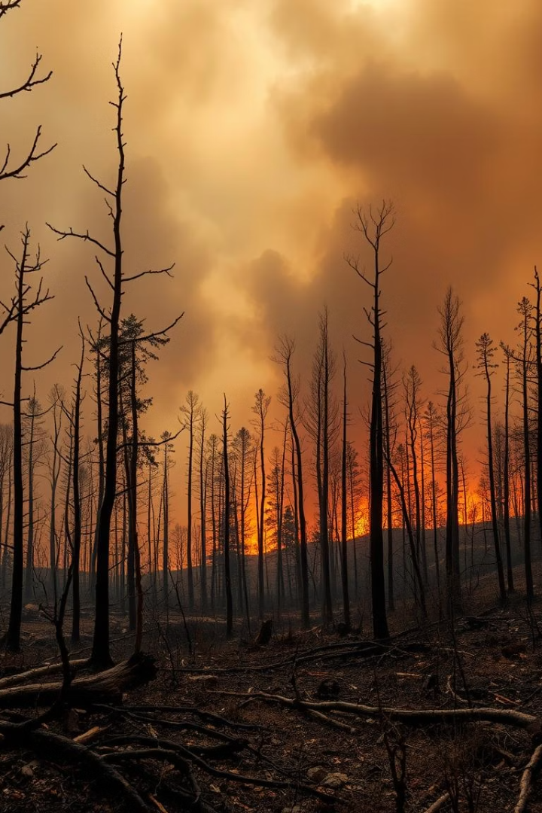



Threats to Forest Resources
Deforestation
Wildfires
Pests and Diseases
Forests face many threats. Deforestation, wildfires, and diseases are common. Illegal logging accounts for significant losses.

Slide 6




Sustainable Forest Management
Balance
Economic, ecological, and social factors.
Certification
FSC and PEFC standards.
Reduced Impact Logging
Minimize environmental damage.
Certified forests cover ~11% of global forest area.

Slide 7






Conservation Efforts Worldwide
Reforestation
Planting new trees.
Protected Areas
National parks and reserves.
Community-Based
Local involvement.
Global Forest Watch monitors forests in real-time.

Slide 8



Case Study: Amazon Rainforest
Importance
Biodiversity and carbon sink.
Threats
Deforestation and fires.
Conservation
Protected areas and indigenous rights.
Amazon stores 80-120B tonnes of carbon (WWF).

Slide 9
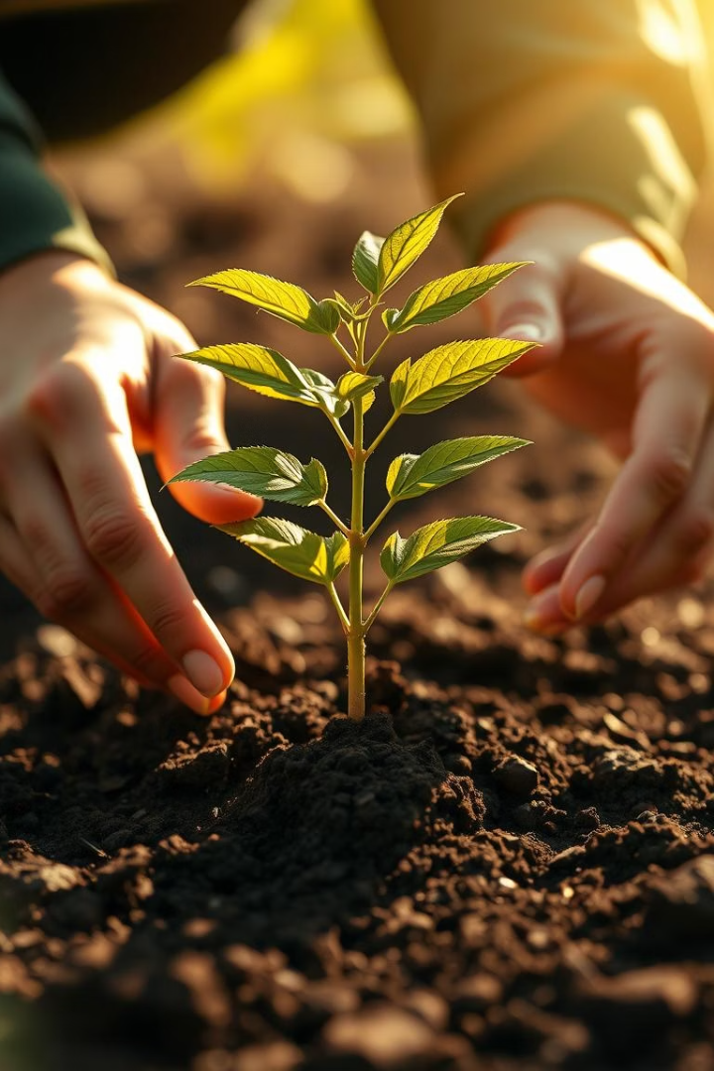
Conclusion: Act Now for Forest Preservation
Forests are vital for our planet's health. Sustainable management is crucial.
Collective action is needed to protect resources.
"The best time to plant a tree was 20 years ago. The next best time is now." - Chinese Proverb

Slide 10
Thank You

